Slide 1
University of Scranton
Study abroad
Pre-departure orientation
For Summer and Fall 2024 Programs

Slide 2
agenda
1. Welcome
2. Conduct Abroad
3. Title IX Presentation – Office of Equity and Diversity
4. Culture Shock
5. Healthcare, Insurance, and Emergency Assistance
6. Courses Abroad
7. Registering for classes and housing at Scranton for Semester Abroad Students

Slide 3

Conduct Abroad
While you are abroad you are still registered as University of Scranton students. The Student Code of Conduct of the University of Scranton remains in effect. Any infraction abroad will result in disciplinary action upon your arrival home, in the event you are not sent home immediately.
Sexual Harassment and Sexual Misconduct Policy
Policy applies to all members of the University community
  Students
  Staff
  Faculty
  Guests/Visitors
Student Code of Conduct and Sexual Harassment/Sexual Misconduct Policy governs off campus conduct of University students and faculty leaders
We expect you to conduct yourself as a representative of the University.

Slide 4

Minimizing risk
Familiarize yourself with local laws and customs.
Avoid traveling alone, especially after dark. Be conscious of your surroundings.
Plan appropriate wardrobe: you do not want to offend the locals, nor draw unwanted attention.
Do not carry large amounts of cash.
Avoid long waits in lobbies and terminals, if possible (pickpockets).
Avoid civil disturbances.
Remain sober and employ the buddy system.
BE SMART

Slide 5
US Dept of State Travel ADVICE
Review country-specific destination advice from the US Department of State:
Travel Advisories:
https://travel.state.gov/content/travel/en/traveladvisories/traveladvisories.html/
Country Security Reports:
https://www.osac.gov/Content/Browse/Report?subContentTypes=Country%20Security%20Report

Slide 6
Understanding the law
Make sure you know the relevant laws for each country to which you plan to travel. Foreign laws apply to visitors, regardless of the visitor’s country of citizenship.
If you find yourself in legal trouble abroad (for example, arrested), the U.S. Embassy or Consulate may only be able to assist you in the following ways:
  Visit you in jail after your arrest
  Give you a list of local attorneys
  Notify your family and friends and relay request for money and other aid
  Intercede with local authorities to help ensure your proper treatment under the law and in accordance with internationally recognized standards
  Protest mistreatment
*Legal Representation: You will be responsible for bearing the financial burden of your legal representation as well as the outcome of a trial.
*Constitutional Rights: You cease to be protected by U.S. law and Constitutional rights once you leave the country.

Slide 7
CULTURE
Whcih mbemer stintig in the aiducene cnaont raed this txet?
你们在座的哪一位能读懂这句话？

Slide 8
Adjusting to life abroad:
Culture shock
Honeymoon Stage/Excitement:
You have feelings of elation and excitement
You are fascinated and intrigued by the host culture
You have positive feelings about the host culture
Negotiation Phase/Withdrawal:
Differences between the two cultures start to create some anxiety and frustration for you
You start to withdraw
You begin to criticize or mock host culture
You have negative feelings about the host culture
Adjustment Phase/Adjustment:
You are growing comfortable with new routines and the new culture
You are accepting differences between cultures
Mastery Phase/Enthusiasm:
You feel confident in your new culture
You enjoy the new culture and adopt some behaviors of the new culture
Culture Irritation:
The feeling of disorientation experienced by someone who is suddenly subjected to an unfamiliar culture, way of life, or set of attitudes.
Everyone experiences culture shock but the degrees of shock may differ.
Culture shock will pass; it is not a permanent affliction!
Regardless of how much you have traveled, you will have a period of adjustment when you travel abroad. There are a few things you can do to make the period of adjustment an easier one for yourself; learn as much about where you are going before you go and understand that you will experience culture shock.

Slide 9
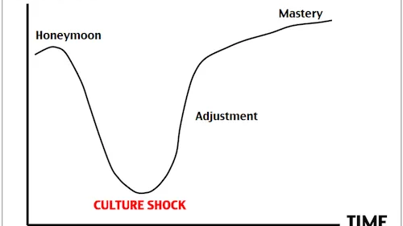

Slide 10
Tips For Overcoming Culture Shock
Be curious
Be open-minded
Be flexible
Get involved with your new community
Focus on the positives and remember your study abroad goals!

Slide 11
More Tips
Get used to walking and daily exercise before you go abroad.
Bring comfortable shoes with you.
You are likely to do a LOT more walking abroad than in the USA.

Slide 12
Budget Tips
Create a budget for yourself for each week you will be abroad.
Make a meal plan budget.
Weekend trips and travel experiences can add up quickly.

Slide 13

Important Documents
Important documents to keep in your carry-on luggage:
  Passport:
    Check your expiry date carefully.
    Countries can require 3 or 6 months remaining validity on your passport in order for you to enter the country.
    If you have family travelling with you, make sure they check their passport expiry dates as well.
  Student Visa:
    Most countries require a visa for you to enter as a student if you will be there more than 90 days.
    Visa application process and timelines vary by country. Your host university will advise you on how to apply for the student visa for your study destination.
    Call or stop by the Office of Global Education if you need additional advice.
  Important papers:
    Host University acceptance letter
    Geo-blue Health card from Scranton and Health Insurance Information from your host university
    Directions to university campus and your accommodation
    Make sure to have copies of all important documents in the event you lose something! If you lose your passport, it is necessary to have a copy of your passport.

Slide 14

Health documents
Have a complete physical exam, dental exam, and vision test prior to going abroad.
If you wear eye glasses or contact lenses, make sure you have extra pair or set with you when you travel. You will also want to have a copy of the prescription.
If you take prescription drugs, make sure you have written copies of all your prescriptions. Also, have both the brand and generic name available.
It is also wise to carry a letter from your physician explaining why the medication(s) are being prescribed. Always use the original medication container when traveling.
Visit the Center for Disease Control and Prevention’s website to determine if you will need any immunizations/vaccinations in order to travel to your study destination (http://wwwnc.cdc.gov/travel/).

Slide 15
Stay Well ABROAD
Stay safe abroad – use your best judgment to avoid getting sick!
Check on immunizations before travelling.
Complete a Health Information form as part of your Scranton study abroad application – for Faculty Led Programs ONLY

Slide 16
Geo-Blue Insurance
Study Abroad students are enrolled in a health and emergency evacuation insurance program through the University of Scranton. GeoBlue insurance covers:
  Routine medical care
  Emergency medical care
  Emergency medical evacuation
  Emergency evacuation due to natural disaster
  Emergency evacuation due to political unrest
  Read through the policy coverage and benefits information here.
Register online https://www.geobluestudents.com/
Download the GeoBlue app onto your phone.
GeoBlue will help you located trusted providers abroad, arrange direct payment to your provider, and submit and track claims. You will need to present your GeoBlue ID card whenever you receive medical care. You can show your ID card through the app.

Slide 17
Registering your Travel
The Smart Traveler Enrollment Program (STEP) is a free service provided by the U.S. Government to U.S. citizens who are traveling to, or living in, a foreign country. STEP allows you to enter information about your upcoming trip abroad so that the Department of State can better assist you in an emergency.
STEP also allows Americans residing abroad to get routine information from the nearest U.S. embassy or consulate.
To enroll in the STEP Program, please navigate to the United States State Department website located here: https://step.state.gov/step/
THIS IS STRONGLY RECOMMENDED!

Slide 18
In the Event of a Real Emergency
Inform/contact university or study abroad program emergency contact person
Inform/contact family in the United States
Inform/contact The University of Scranton
If necessary, seek medical attention
If necessary, seek legal advice/intervention
Notify local law enforcement authorities
Contact nearest embassy/consulate
Inform/contact insurance company
*Note: Know the equivalent for 911 while abroad.
http://travel.state.gov/content/dam/students-abroad/pdfs/911_ABROAD.pdf
Real emergencies include, but are not limited to:
  Physical assault
  Robbery
  Sexual assault
  Rape
  Serious physical or emotional illness
  Serious accident and/or injury
  Hospitalization for any reason
  Terrorist threat or attack
  Political crisis that poses potential danger or concerns about safety
  Any legal action
  Infectious disease outbreak

Slide 19

Emergencies abroad
Have a plan in place before an emergency occurs.
Have emergency contact information available.
Study Abroad Office contact:
Ms. Kara Bishop
Telephone 570-941-4303
WhatsApp 570-892-8025
Email: kara.bishop@scranton.edu
The University of Scranton
May be contacted in one of the following two ways:
  800-709-8703
  or
  570-941-7777 (Police available 24/7)
Make an Emergency Card to take with you when you travel:
Geoblue Insurance offers 24/7 assistance including medical evacuation call 1-610-254-8771 (collect calls accepted) or email globalhealth@geo-blue.com
Contact information for local police/911 equivalent
Host institution international office or program coordinator phone number
Phone number for your accommodation (dormitory, apartment complex, housing office)
An emergency contact at home
University of Scranton emergency number
Nearest hospital
The nearest US embassy or consulate address and phone number

Slide 20
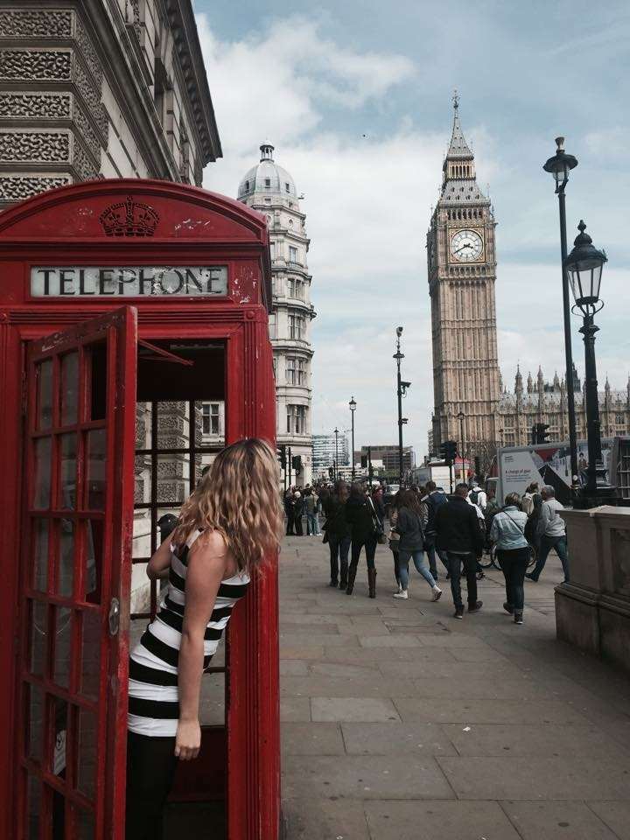

When you arrive:
CALL HOME!
And stay in touch while abroad
Set aside a regular time or day to call or text your family

Slide 21
  Additional Resources for Students
  US Department of State: 202.501.4444 for lost passports or emergency assistance abroad
  University of Scranton Counseling Services: 570.941.7620
  University of Scranton Student Health Services: 570.941.7667
  Women’s Resource Center of Lackawanna Country: 570.346.4671
  National Sexual Assault Hotline: 800.656.4673
  University of Scranton Dean of Students: 570.941.7680
  University of Scranton Campus Ministries: 570.941.6645
  University of Scranton Title IX Coordinator: 570.941.6645
  University of Scranton Jane Kopas Women’s Center: 570.941.6194
  University of Scranton Police Department Office: 570.941.7888

Slide 22
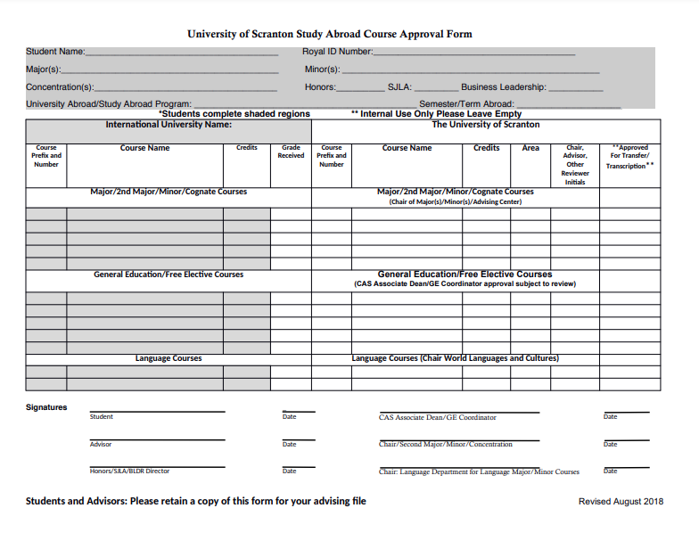
Schedule changes while abroad
For Students STUDYING on A Host University Program

Slide 23
Schedule changes while abroad
You are expected to update your advisor as well as the Office of Global Education, if you make any changes to your approved courses.
In the event courses are added or changed, you are expected to provide the same information to your advisor as you did for your initial Course Approval Form. The process for approving the courses is the same as with the original approval request.
The Office of Global Education reviews all transcripts from abroad. As a result, any and all course changes/approvals must be communicated to the office. This is in order for credits posted on foreign transcripts to transfer. Failure to have additional courses approved could result in credits not transferring.
Always CC noelle.drozdick@scranton.edu to any emails regarding schedule changes

Slide 24
Registration from abroad
How to register for Spring 2025 classes if you are abroad in Fall 2024.
PCPS & KSOM students
  Email your advising center a list of courses you are currently taking and a list of courses you would like to take in the Spring 2025 semester.
  Your advisor will manually register you into classes prior to web registration.
  You will receive a pin via email to access the system after your regularly scheduled registration period.
PCPS should email: kevin.curry@scranton.edu
KSOM should email: kevin.stanford@scranton.edu

Slide 25
CAS students
  Email your academic advisor a list of courses you are currently taking and a list of courses you would like to take in the Spring 25 semester.
  Your advisor will review your selections and contact you with any changes and a final approval.
  The Dean’s office will manually register you into the courses and give you a pin for future changes you would like to make.
  If you do not know who your advisor is, please contact your Dean’s office or Registrar’s office.

Slide 26

Housing for next semester
For those studying abroad during Fall semester, and returning to campus in the Spring semester
  Contact Residence Life if you require housing in Spring 2025. res-life@scranton.edu

Slide 27
Good Luck on Your STUDY ABROAD Journey!

